Slide 1

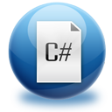
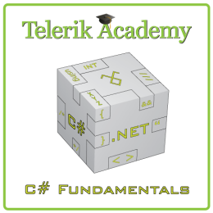


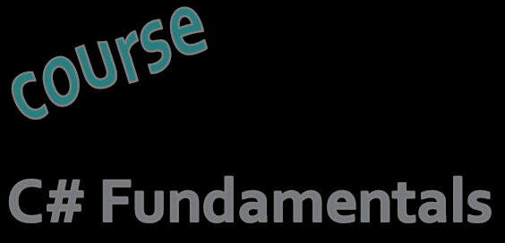
C# Programming Course – Part I
About the Course
Svetlin Nakov
Manager Technical Training
www.nakov.com
Telerik Software Academy
academy.telerik.com

Slide 2



Table of Contents
Course Objectives
Course Program
Trainers Team
Examination
Learning Resources
C# Programming

Slide 3
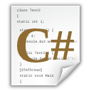


C# Programming: Objectives & Program
What Topics Shall We Cover?

Slide 4
C# Course Objectives
The C# Programming track at the Academy:
Give the trainees the fundamental computer programming knowledge and skills
Establish the logical and algorithmic thinking
Development of problems solving skills
Learn basic data structures, algorithms and object-oriented programming (OOP) concepts
Learn to produce high-quality code
Prepare for learning the software technologies
HTML5, DB & SQL, ASP.NET, XAML, Win8, …

Slide 5
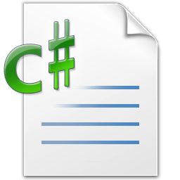
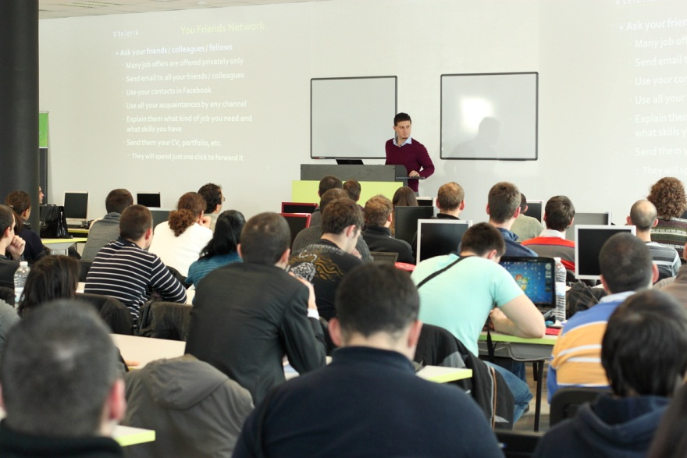
C# Part I – Course Topics
Introduction to Programming
Primitive Data Types and Variables
Operators, Expressions and Statements
Console Input / Output
Conditional Statements
Loops
Exam Preparation
C# Programming Test
C# Practical Exam

Slide 6
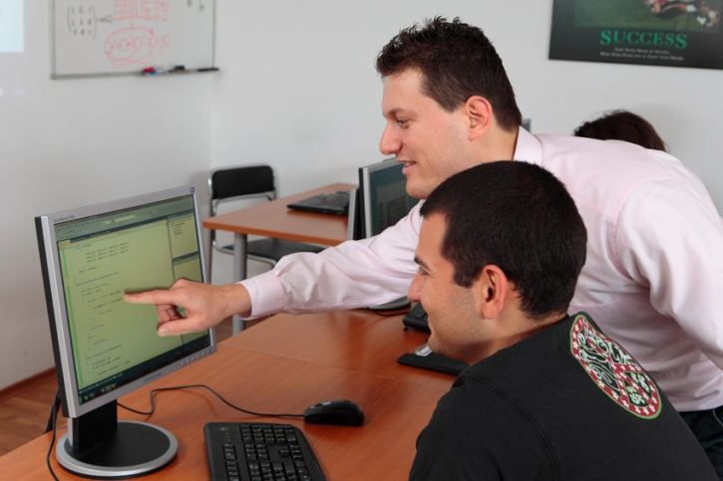
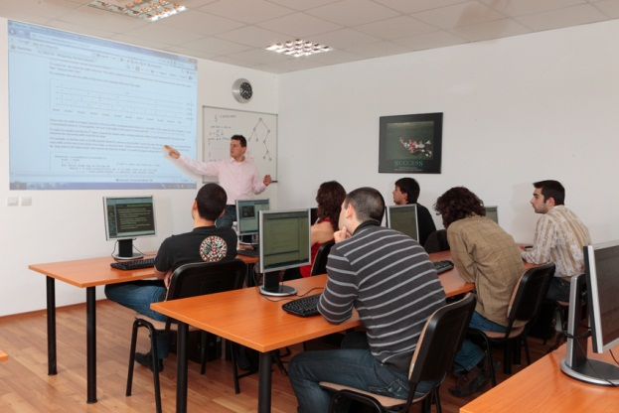
C# Part II – Course Topics
Arrays and Matrices
Numeral Systems
Methods
Creating and Using Objects
Strings and Text Processing
Problem Solving Methodology
Exam Preparation
C# Programming Test
C# Practical Exam

Slide 7


OOP – Course Topics
Object-Oriented Programming Basics
Defining Classes: Constructors, Visibility
Defining Classes: Fields, Properties, Methods
Exceptions Handling
OOP Principles: Abstraction, Encapsulation, Inheritance, Polymorphism
Interfaces, Abstract Classes, Templates, Indexers
OO Modeling with UML
Team Work: Creating OOP Game
OOP Exam Preparation
OOP Test and Practical Exam

Slide 8

High-Quality Code – Topics
Definition of High-Quality Code. Entrance Project
Naming the Identifiers. Code Formatting
High-Quality Classes. High-Quality Methods
Correct Usage of Variables, Constants, Conditional Statements and Loops
Defensive Programming and Exceptions
Code Documentation and Self-Documenting Code
Unit Testing and Test-Driven Development (TDD)
Code Refactoring. Refactoring Patterns
Practical Project & Defense

Slide 9
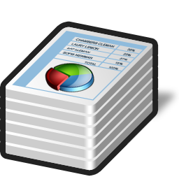
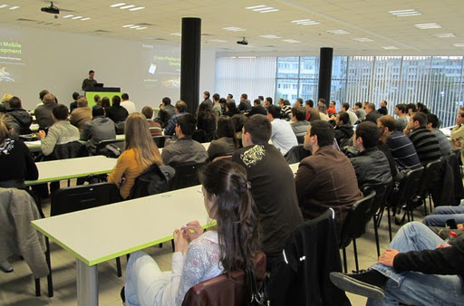
Data Structures & Algo – Topics
Linear Data Structures: Lists, Stacks, Queues
Trees and Graphs. Balanced Search Trees
Dictionaries, Hash-Tables and Sets
Complexity of Algorithms. Data Structures Efficiency
Sorting and Searching Algorithms
Dynamic Programming
Recursion and Combinatorics
Graph and Tree Algorithms
Problem Solving Methodology
Exam Preparation & Practical Exam

Slide 10
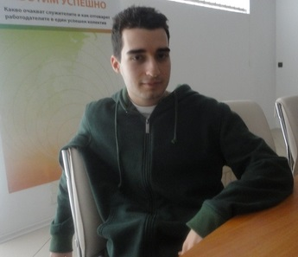
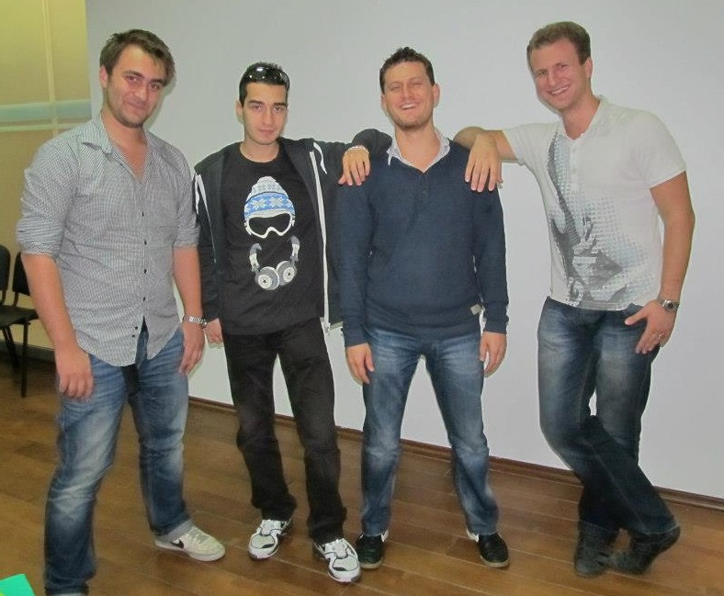
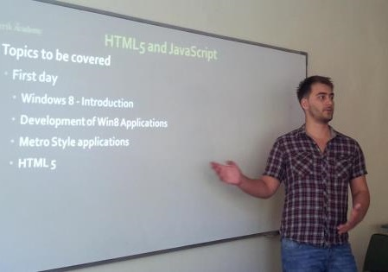
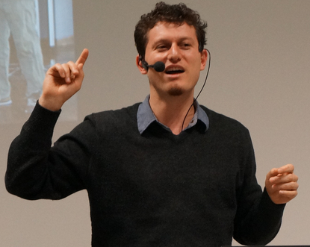
Trainers Team

Slide 11
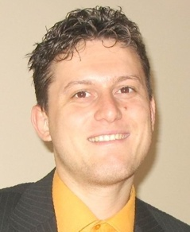
Trainers Team
Svetlin Nakov, PhD
Manager Technical Training @ Telerik Software Academy
20 years software development experience
10+ years experience as trainer
Author of 6 books
Speaker at hundreds of events
E-mail: svetlin.nakov [at] telerik.com
Web site / Blog: http://nakov.com

Slide 12

Trainers Team (2)
Nikolay Kostov
Technical Trainer @ Telerik Corp.
Student in Sofia University
Computer Science
Contestant in the IT and Informatics competitions
Graduate from the second season of Telerik Software Academy
Email: nikolay.kostov [at] telerik.com
Blog: http://nikolay.it

Slide 13

Trainers Team (3)
Doncho Minkov
Technical Trainer @ Telerik Software Academy
Student in Sofia University
Software Engineering
Contestant in the Informatics competitions
Graduate from the first season of Telerik Software Academy
Email: doncho.minkov [at] telerik.com
Blog: http://minkov.it

Slide 14
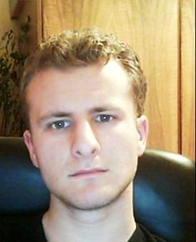
Trainers Team (4)
George Georgiev
Technical Trainer @ Telerik Corp.
Informatics and IT competitions contestant and winner
Student in Sofia University
Software engineering
Graduate from the third season of Telerik Software Academy
E-mail: georgi.georgiev [at] telerik.com
Blog: http://itgeorge.net

Slide 15
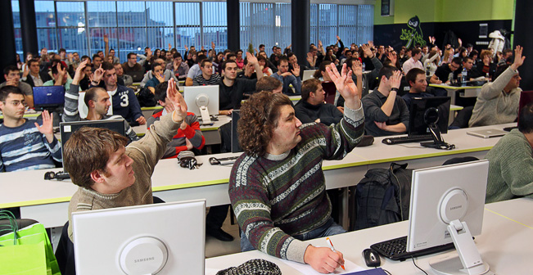
Volunteer Assistants
50+ volunteer teaching assistants
Students from Telerik Academy (Sep 2012)
Top results in all programming exams

Slide 16
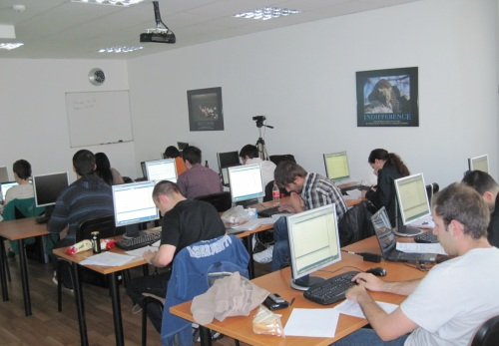

C# Programming Course – More Details
Duration, Languages, Technologies

Slide 17

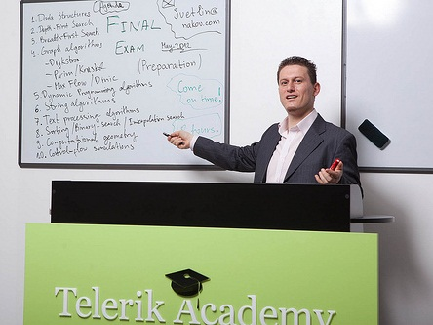
Training Duration – C# Part I
Lectures: ~ 15 hours (@ YouTube)
Practical exercises: ~ 24 hours
Homework: ~ 50-100 hours
Test: 1 hour
Exam: 6 hours
Allocation
Timeframe: April 2013 – June 2013
Exam: end of June 2013

Slide 18

Why C# and .NET Framework?
Microsoft is very strong industry leader
.NET Framework and C# are the primary development technologies in the MS ecosystem
The C# language
Modern object-oriented language
Widespread and very popular
Easy to learn
Most Telerik products target the .NET platform

Slide 19


Why English?
Why the slides are in English?
English is the native language of the software engineers
Just learn it!
Specific terminology should be in English
Translations are inaccurate and funny

Slide 20
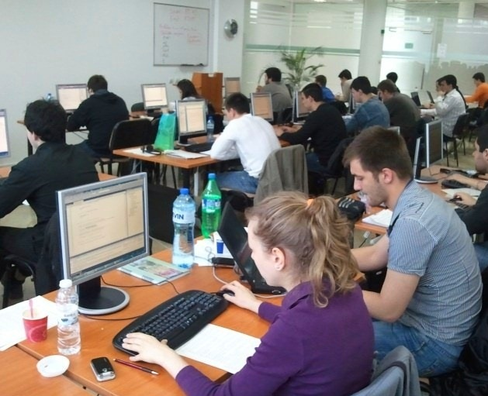
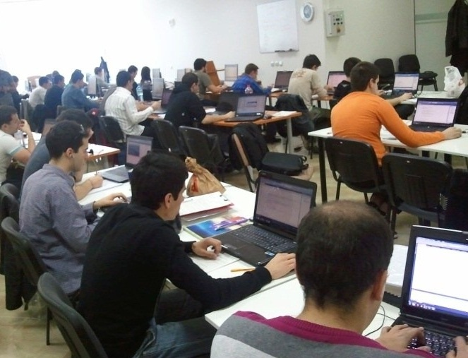
C# Part I Exams
Test & Examination Criteria

Slide 21

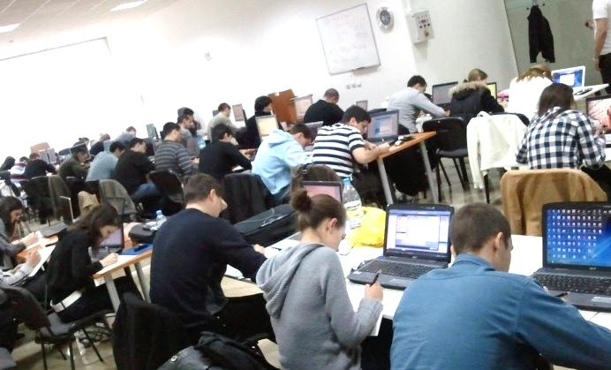
Exams @ Software Academy
Exams measure the individual performance
Serve as filter for the most skillful people
Score formed by many components:
Test and exam results, forums activity, homework, lectures attendance, etc.

Slide 22
Scoring System for C# Part I
Test – 15%
Serves as primary pass / fail criteria
Exam – 50%
Serves as pass / pass with excellence criteria
Homework + evaluation – 10% + 10%
Team work – 15%
Forums activity – bonus up to 10%
Helping the other students – bonus up to 10%
Knowledge sharing / blogging – bonus up to 10%

Slide 23
C# Part I Exams
C# Programming Test
30 questions for 1 hour
Choose the correct among few answers
Best students pass to the practical (real) exam
Practical Programming Exam
3-5 practical problems for 6 hours
Covers all learned topics up to the moment
Automated judge system & real-time feedback
Solutions are evaluated for correctness only

Slide 24
Homework Peer Reviews
Everyone will get feedback for their homework
Everyone will give feedback for few random homework submissions
Students submit homework anonymously
Please exclude your name from the submissions!
For each homework submitted
Students evaluate 3 random homeworks
From the same topic, after the deadline
Give written feedback, at least 200 characters
Low-quality feedback → report for punishment

Slide 25
C# Test – Sample Question
You are given the following C# code:
What will be the output?
static void Main()
{
int n = 5;
int m = 7;
int result = n / m * 3;
Console.WriteLine(result);
}
3
2.142857
0
4.2
compilation error
runtime error

Slide 26

Pass / Fail / Excellence Criteria
C# Part I – pass / fail / excellence criteria:
Test
Very low results → fail (course not taken)
Average results → pass (course taken)
High results → practical exam
Practical exam
Low results → pass
High results → pass with excellence

Slide 27
C# Exam – Sample Problem
Write a program that enters a positive integer number N from the console and prints two symmetric triangles of size N separated by a vertical line, just like in the examples below:
N = 1
|
* | *
N = 2
|
* | *
** | **
N = 3
|
* | *
** | **
*** | ***
N = 5
|
* | *
** | **
*** | ***
**** | ****
***** | *****

Slide 28
The Judge System at the Exam
All exams will be tested automatically
Through our online judge system (BG Coder)
During the exam preparation you will practice how to use the automated judge system
You can register at any time to practice
How the testing (judge) system works?
You submit your C# source code
It tests your solution against predefined tests
For each test passed you get some score

Slide 29
Homework Assignments
Doing your homework is very important!
Programming can only be learned through a lot of practice!
After each lecture there are few exercises
Try to solve them in class
The rest are your homework
Homework assignments are due in 2 weeks after each lecture
Submission will be accepted through the student's system: telerikacademy.com

Slide 30








Resources
What We Need in Addition to this Course Content?

Slide 31

The C# Textbook
The official textbook for the course
“Introduction to Programming with C#”, Nakov S. and his team, 2010
Freely downloadable from: www.introprogramming.info
The C# programming tracks follows the book
C# Part I → chapters 1..6 (up to Loops)

Slide 32
Course Web Site & Forums
Register for the "Telerik Academy Forums":
Discuss the course exercises with your colleagues
Find solutions for the exercises
Share source code / discuss ideas
The C# Part I official web site:
forums.academy.telerik.com/csharp-fundamentals
http://telerikacademy.com/Courses/Courses/Details/81

Slide 33

Telerik Integrated Learning System (TILS)
The Telerik Integrated Learning System (TILS)
www.telerikacademy.com
Important resource for all students
Homework submissions
Reports about your results
Presence cards (barcodes)
Calendar, team work
Etc.

Slide 34


Required Software
Software needed for this course:
Microsoft Windows (XP / Win7 / Win8)
Microsoft Visual Studio 2012 or Visual Studio Express 2012 (free version of VS 2012)
.NET Framework 4.5 (included in Visual Studio)
Visual Studio 2005, 2008 or 2010 is also OK

Slide 35
C# Programming Course – Part I
http://academy.telerik.com

Slide 36


Free Trainings @ Telerik Academy
Fundamentals of C# Programming Track of Courses
csharpfundamentals.telerik.com
Telerik Software Academy
academy.telerik.com
Telerik Academy @ Facebook
facebook.com/TelerikAcademy
Telerik Software Academy Forums
forums.academy.telerik.com

